Slide 1




Energy efficiency: Meeting the Climate Emergency and the Energy Bill Crisis
3rd September
Boddington Village Hall

Slide 2
10.15 Welcome – Host: Olivia Davies, Boddington Sustainability Group
Boddington Sustainability Group
RSA
LCWN
CA-WN
You
10:45 Main Speakers – Host: Mark Thompson, Boddington Sustainability Group
The Climate Challenge and Opportunity, Mark Thompson, Boddington Sustainability Group
Tips and Tricks to optimise your system, Jo Alsop, The Heating Hub
Heat Pump Installations – Kimbo, Heating Academy
Hybrid Heat Pumps - Stephen Kelly, Oya Energy
Thermal Imaging Camera - Chris Colles, Boddington Sustainability Group
Q&A
11:55 Refreshments
13:00 Wrap Up

Slide 3
The Climate Challenge and Opportunity
Dr Mark Thompson CPhys
3rd September 2022
Notes:
Today we have assembled a varied group of esteemed guests - experts, knowledgeable bystanders and those who have taken the time and interest to learn a little more.
Before we hear from some of our speakers, I thought I would take a few moments to give some context for the session
So I am going to talk briefly about the science, followed by some, hopefully interesting facts on the home energy challenge.

Slide 4
Climate change refers to long-term shifts in temperatures and weather patterns. These shifts may be natural, such as through variations in the solar cycle. But since the 1800s, human activities have been the main driver of climate change, primarily due to burning fossil fuels like coal, oil and gas.

Slide 5
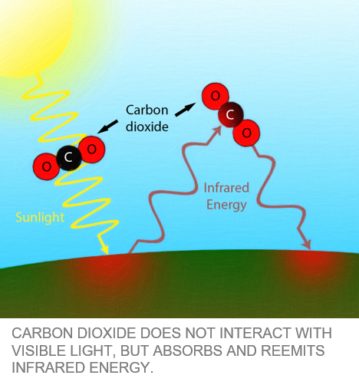
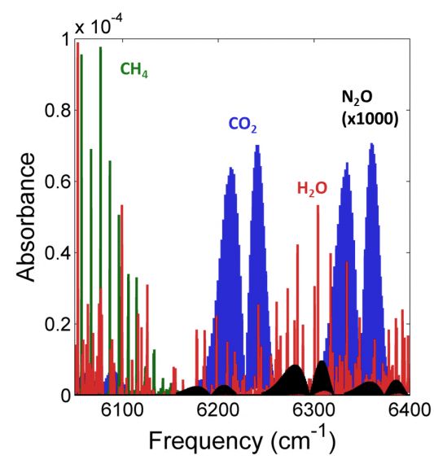
Notes:
The basic physics of the greenhouse effect as a result of CO2 has been understood for over 200 years.
CO2 passed visible without much effect; the longer infrared radiation from the Earth’s surface is partially absorbed as a result of the coupled vibrational and rotational energy transitions within the molecule.
Increased levels of CO2 in the atmosphere create a slight warming effect.
The intensity of energy that reaches Earth’s atmosphere is called solar irradiance and is 1,360 W/m².
Without any CO2, the Earth would be -18C - so its useful. The average temperature of the Earth is about 14C as a result.
Warming adds just 4W/m2.
Doesn’t sound a lot but the earth is big - and it therefore equates the heat equivalent of 3 Hiroshima bombs exploding every single second. Imagine that!
But CO2 is not the only greenhouse gas; as illustrated by the figure on the right which shows methane, water vapour and nitrous oxide (aeroplanes).

Slide 6
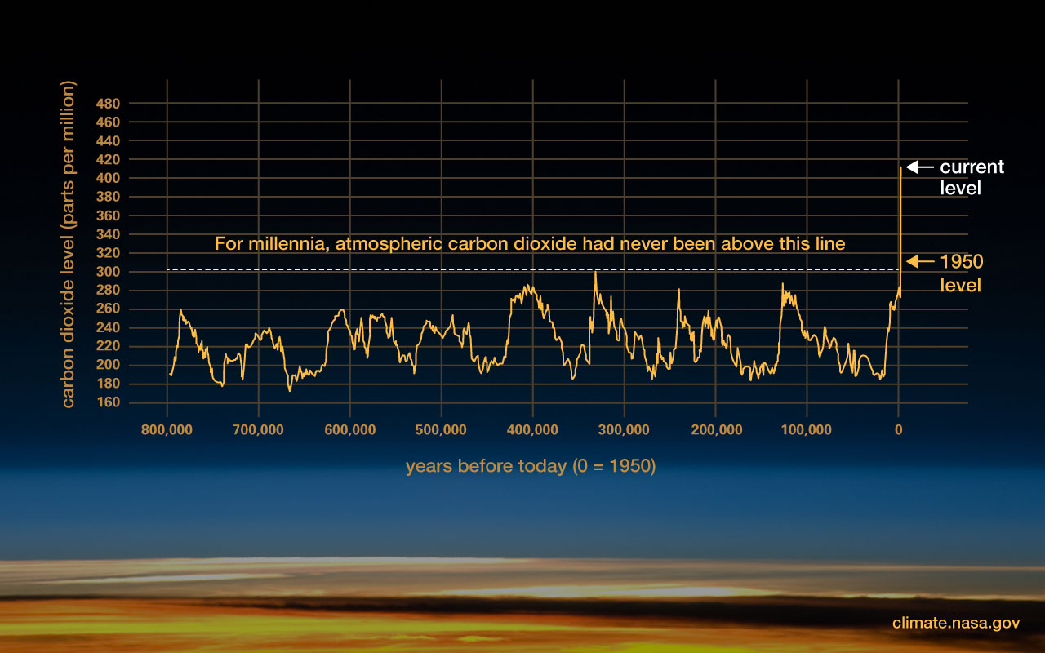
Notes:
Fossil fuels release greenhouse gasses - primarily CO2 and methane that blanket the Earth, trapping the sun’s heat - this leads to global warming and climate change.
Currently CO2 makes up 416 ppm of the atmosphere
Carbon dioxide levels in the atmosphere have always varied and currently it is growing at a rate of around 2.3ppm.
In my 50 years on this earth it has increased by 30% (from 325ppm).
It is the rate of change that is most alarming - you can see the change is so dramatic since 1950.

Slide 7
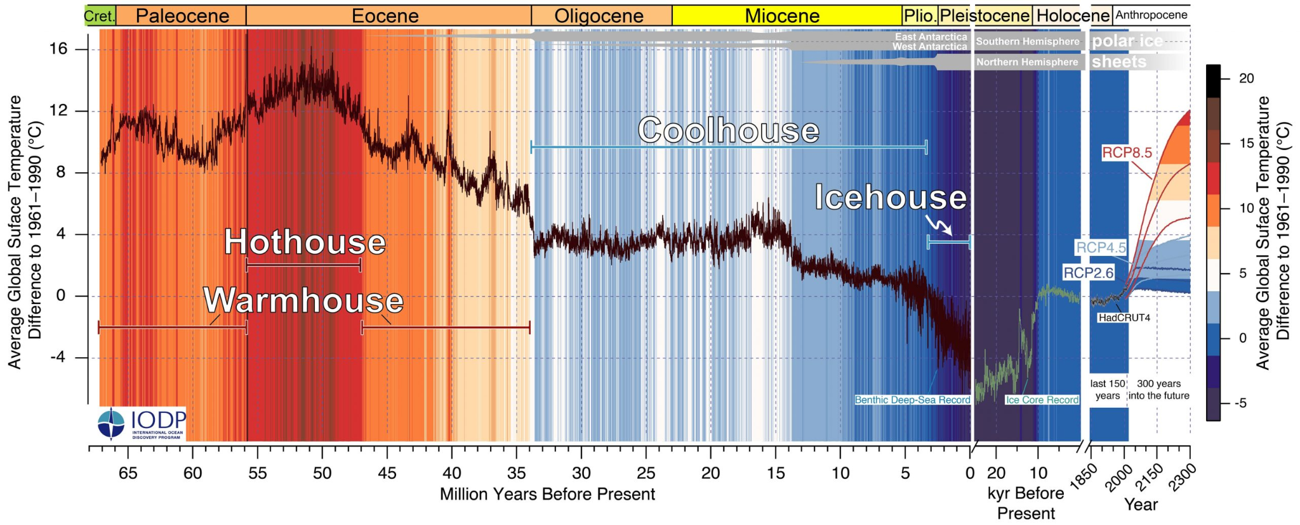
Science, Sept 2020
Notes:
The temperature of the Earth has also always changed - and here we see the change over the last 66 million years.
During the hothouse Eocene - the Earth had no ice and sea levels were the equivalent of 200m higher than they are today – for context Upper Boddington is around 150m above sea level. I suggest we don’t want to go there again!
The Earth has warmed by around 1.1C since the industrial revolution. On land - here in UB we have warmed 1.3C.
The cause of this rapid change is the burning of fossil fuels : coal, oil gas.

Slide 8
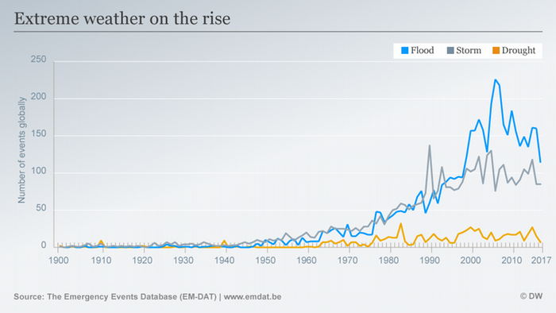
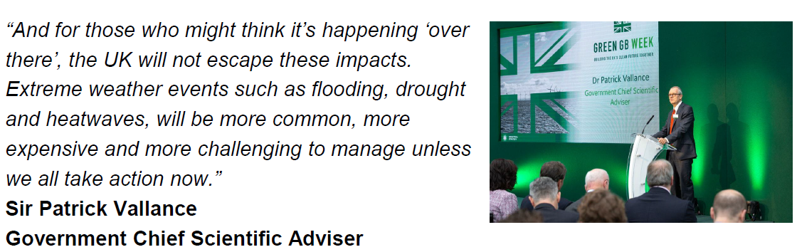
Notes:
So what's the problem? The long dry, warm summer has been quite nice.
For the last 10,000, as part of the Holocene, humans have benefited from relatively stable climate.
This regularity of the seasons has allowed the development of agriculture which was key to the human race developing and sustaining the world's population.
We can see from the data that extreme weather is on the rise – although this stops at 2017 – and the last five years have been worse.
With climate change, the increased heat, or entropy - the weather is becoming less predictable.
Droughts are increasing.
Heavy rainfall is leading to devastating floods.
Heat and drought is leading to an increase in wildfires.
Hurricanes are becoming about 10% more powerful per degree C.
Sea levels are rising at 4mm a year.
Extinction of large populations of the insects and mammals we rely on as part of this ecosystem.

Slide 9
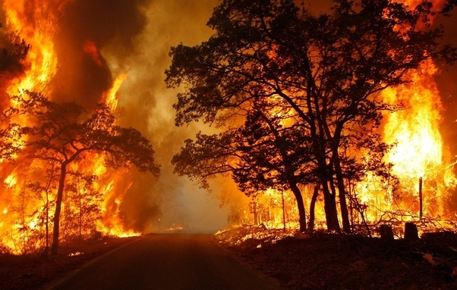
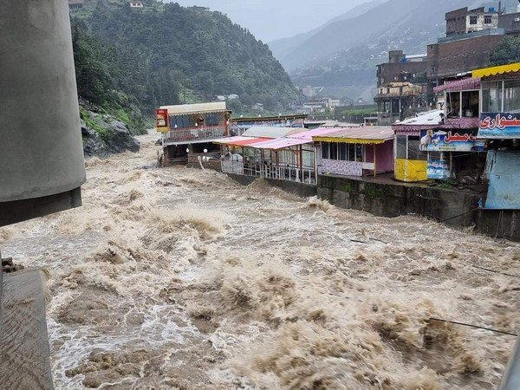
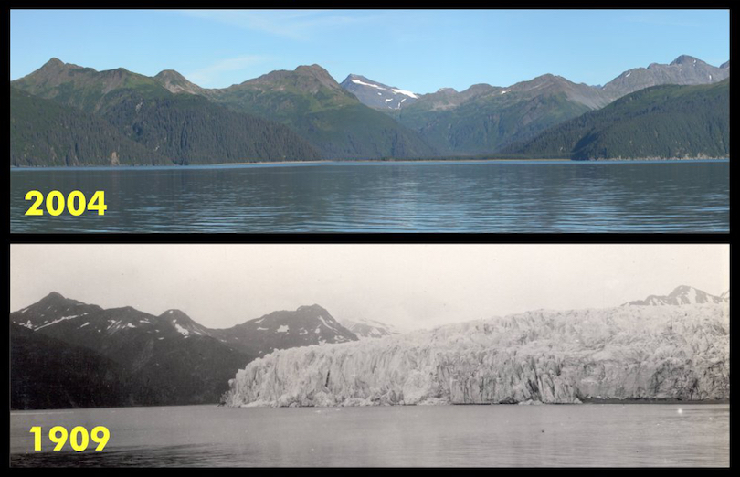
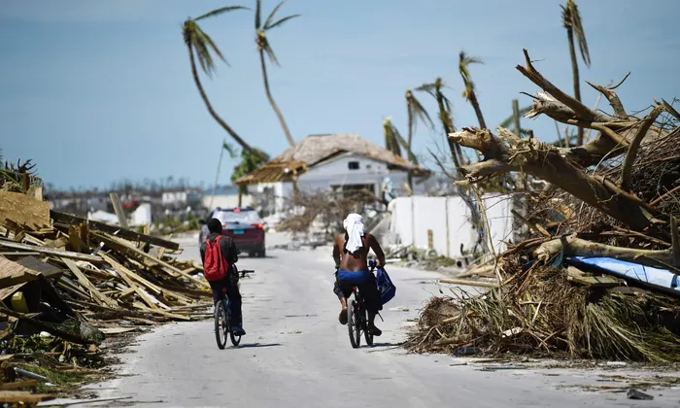
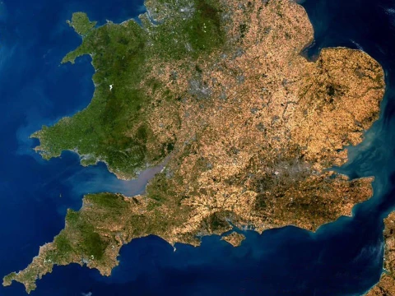
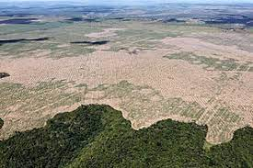
Notes:
Illustrations of a few Climate Impacts
This year …
Iraq hit sustained and unliveable temperatures in excess of 50C.
The Yantzi River in China has dried up in part.
Arctic hit temperatures earlier this year were 30C above average and the Antarctica 40C - first time ever recorded by a long way!
By 2100, sea levels will be between 0.26 metre and 0.77 metres higher than today and threaten 200 million people who live in low-lying coastal areas.
For every 1 deg of warming, it is estimated that 400m people will become displaced as their homelands become uninhabitable
In the UK this year, 745 wildfires (2.5 football pitched) more than three times the total figure of 247 for all of 2021 – including 150 in the July week of 40C temps.
The 40C heat led to an increase in calls to the London Fire Brigade by 1600%
Food production has been severely affected - half of the potato crop is expected to fail as it cannot be irrigated, and even crops that are usually drought-tolerant, such as maize, have been failing. In fact, crops have failed across the globe this year. If you think food inflation is bad at the moment, just wait for this to become more regular.
Pakistan has one-third of its land currently underwater; the volume of rainfall has been staggering with some 700mm (28 inches) having been dumped on the south-eastern province of Sindh, nearly six times the 30-year annual average. 33m are homeless – imagine that 50% of the UK population homeless.
Barbados last year experienced Hurricane Dorian with 185 mph winds.
Storm Eunice in UK February 2022 cost the country £500m.
Conclusion - Left unchecked - we will experience increases in all of these - leading to starvation civil displacement and the breakdown of civilization.
There is no safe level - but by keeping the increase in temperature to below 1.5C we will limit it.
But enough of the doom.

Slide 10
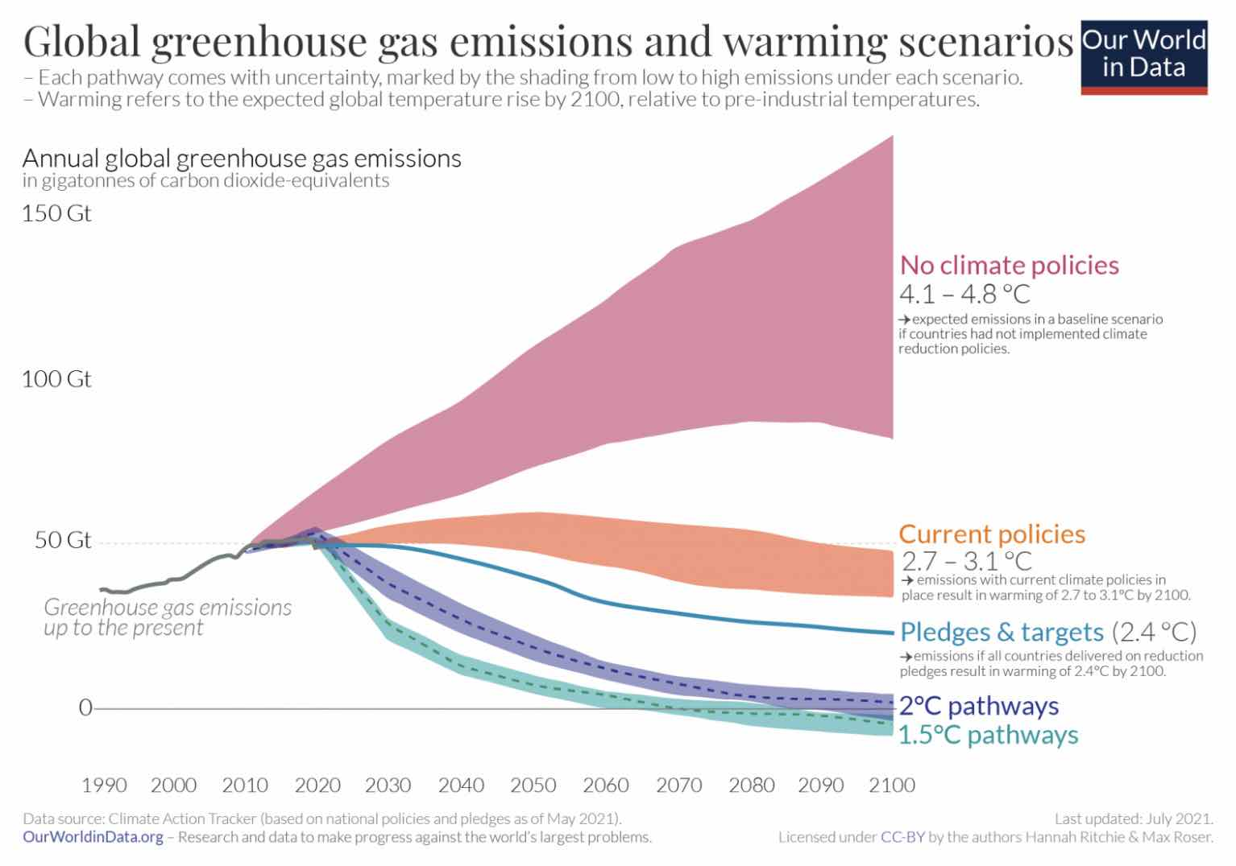
Notes:
Climate pathways – we are currently heading for 2.5C.
Limiting warming to around 1.5°C requires global greenhouse gas emissions to peak before 2025 at the latest, and be reduced by 43% by 2030.
Every single excuse for action – by yourself, companies, or governments is putting us on the 4.8C pathway. That is the choice we are making.

Slide 11
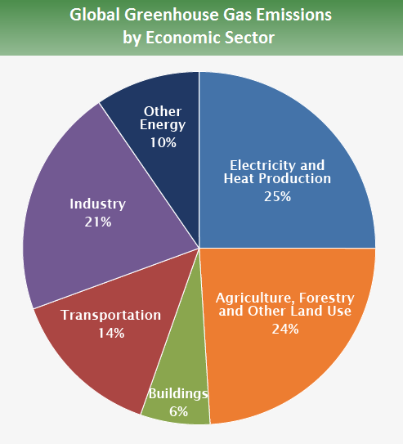
36 Giga Tonnes per year
9 Giga Tonnes per year : Global
Average CO2e footprint in the UK is approx 20 tonnes per household per annum. 30 CO2e tonnes for Boddington.
for Boddington’s 290 households, this equates to 9,000 tonnes of CO2e emissions.
Notes:
Now onto home energy.
Globally emissions are around 36gig tonnes per year – 9 relate to heating and electricity.
To offset Boddington’s footprint we would need to plant 154 acres of trees every single year – and keep them alive for a long time.

Slide 12
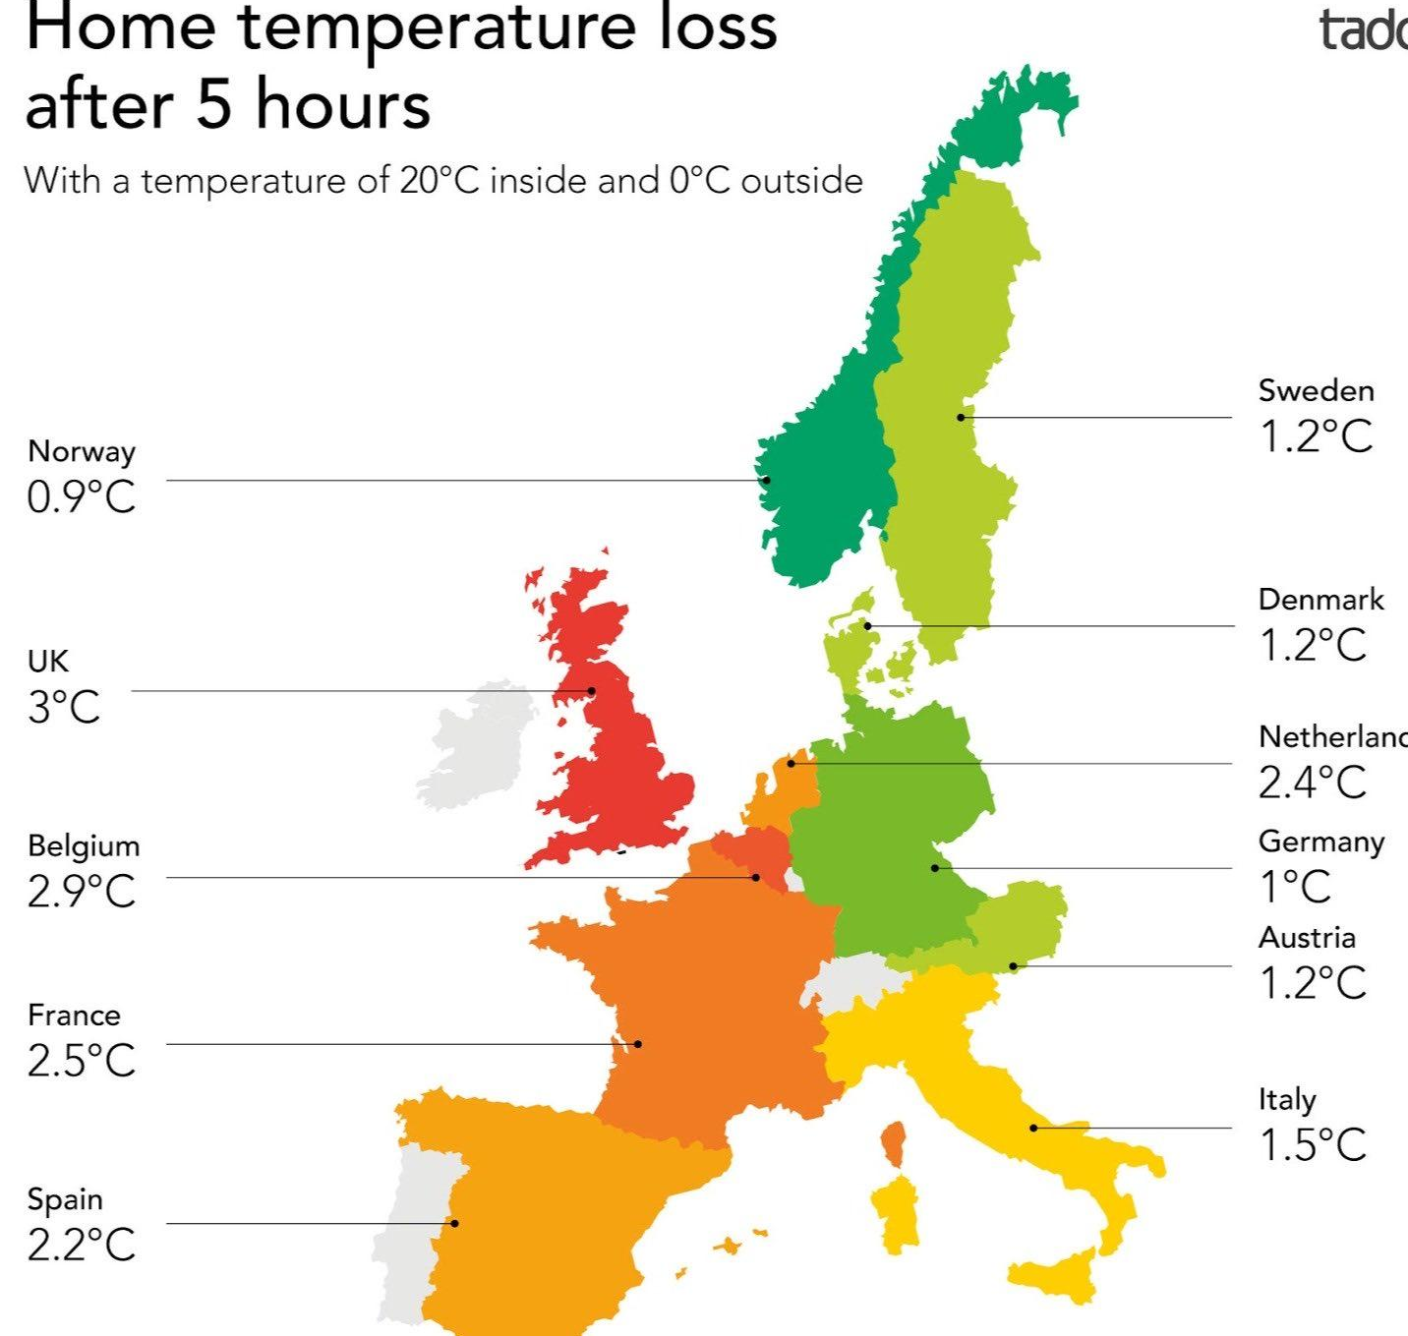
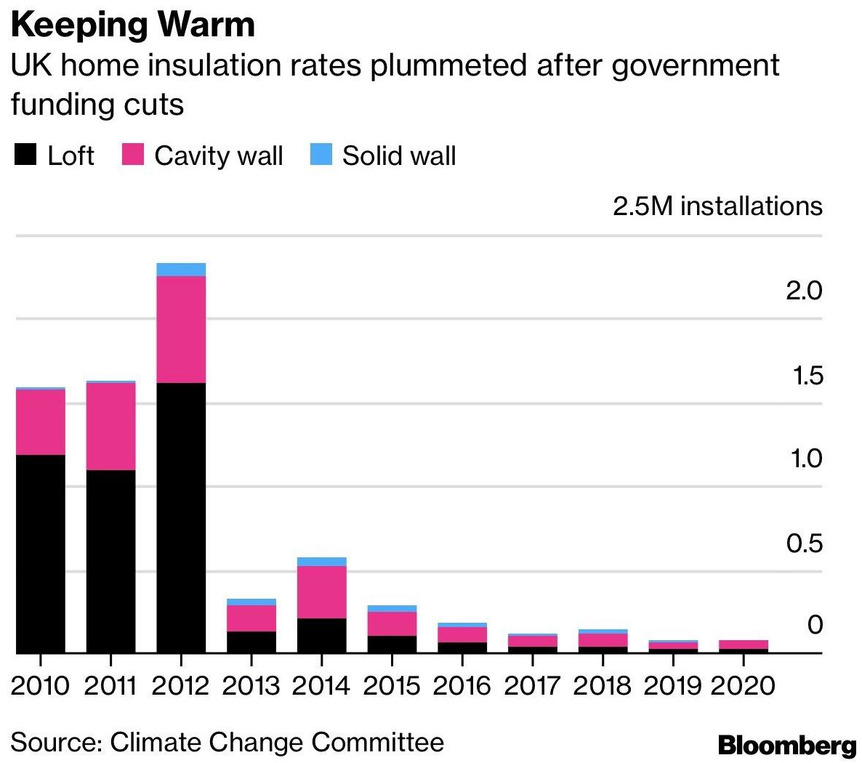
Home Energy - The Challenge
UK produces around 420 million tonnes of CO2 emissions per year.
Emissions need to fall by about a quarter by 2030 from 1990 levels to meet the carbon budget
68 million tonnes (15%) comes directly from its 29 million homes - largely from boilers burning gas/oil for hot water and space heating.
Average UK household of 2.4 people uses 15,000 kwh of energy per year heating and powering their home - 8kwh elec / 33kwh heating per day.
Decarbonising the way homes are heated – meaning more efficient homes and the electrification of most heating systems. Cost estimated £200 billion over the next 30 years.
Notes:
The primary problem is that our houses are not - on average - efficient.
Unfortunately, the UK Government de-prioritised home insulation funding - and now needs to ramp up efforts.
£200billion is the estimate to decarbonise homes. Sounds a lot, but in the same timeframe we will spend £112 billion on coffee (£4b pa) and £560 billion on takeaways (£20b pa)

Slide 13
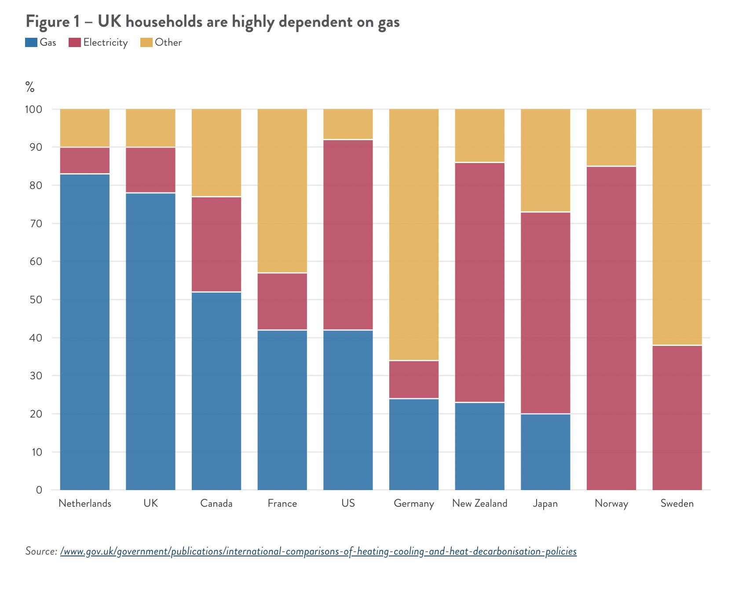
UK highly dependent on gas
Gas storage decommissioned - although Rough Storage now being brought back on line
Problem is GRID pricing mechanism prices all energy at highest marginal cost, which is gas (9 x cost of wind).
Solutions:
CFDs
Smart meter 4 demand management
Battery storage

Slide 14
Home Energy - The Opportunity
What we can do….
Insulation and Draft Proofing
1% of UK homes have zero loft insulation and 31% have below standard levels (<125mm) of loft insulation. Applied to Boddington, that suggests around 90 of the 290 houses in the parish could benefit from increased loft insulation.
If current EPC band D rated homes were retrofitted to achieve band C performance, households would save £511 a year under the proposed 2022 energy price cap. It is estimated that close to two-thirds of homes need no more than £1,000 spent on retrofitting energy efficiency measures.
A thermal imaging camera can help identify where to target efforts.
Boiler Optimisation
Optimise what you have … listen to Jo!
Electrify Heating - Switch from oil and gas to use of Heat Pumps
ASHP around £10k to install. BEIS funding 90,000 5k grants.
50k installed to-date - target 600k by 2028
Reduces gas use by 85% even with current UK electricity energy mix
Decarbonise electricity - Transition of UK Electrical Grid to Renewable
Wind: UK has 11k turbines with installed capacity 25GW (14GW onshore : 11GW offshore). 86GW in pipeline.
Solar: UK 14GW capacity : 3000 installs of solar at home per week / 600MW installed this year already
Gov target of 2035 for renewable grid; 50GW wind and 70GW solar by 2050.
About £5k for an install - payback can be just a few years with new prices.

Slide 15
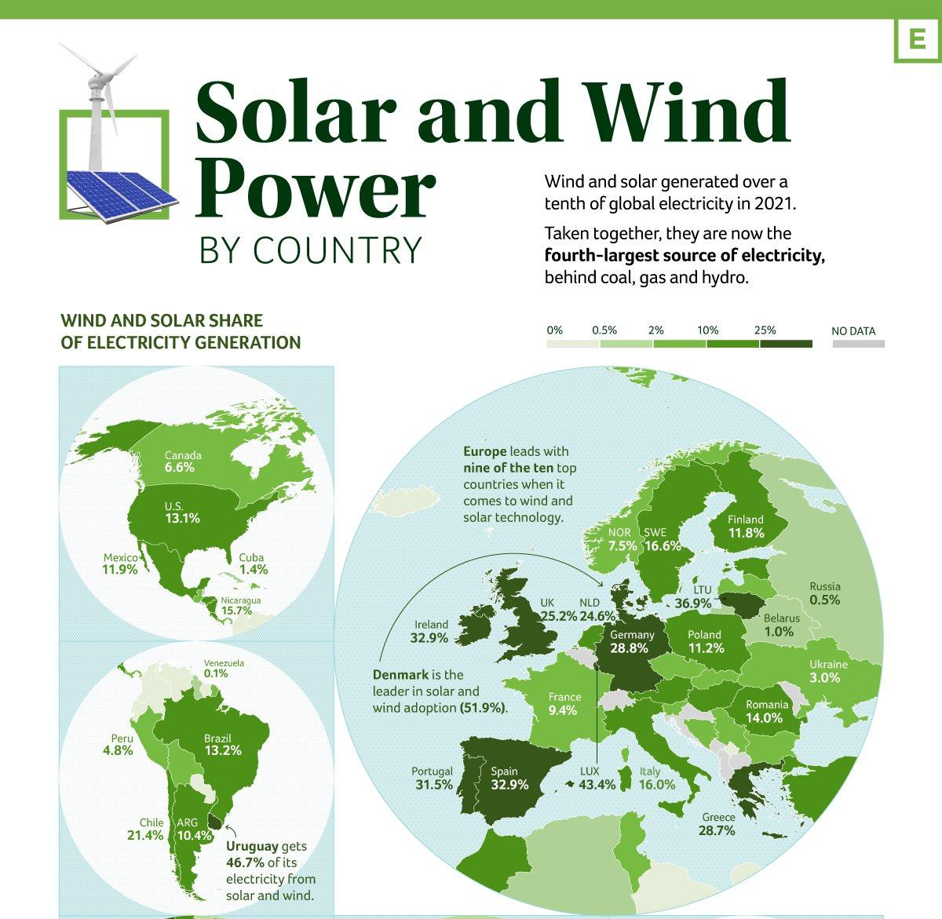
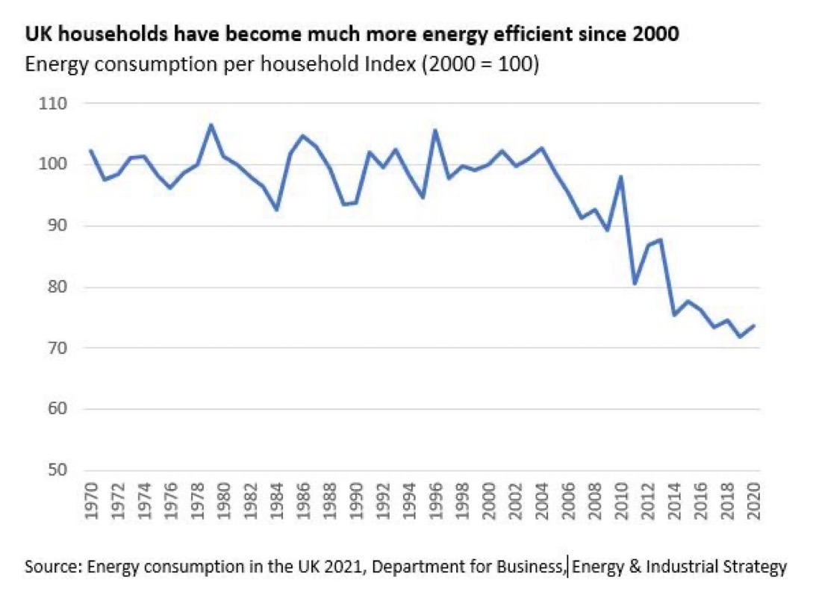
To date in 2022…
Wind has generated 50TWh of electricity
Avoiding need for 100TW of gas which would have cost more than £7 billion
Currently gas costing 9 times cost of wind.
Notes:
Compared to other countries we are performing well.
Although China is due to take over soon…

Slide 16
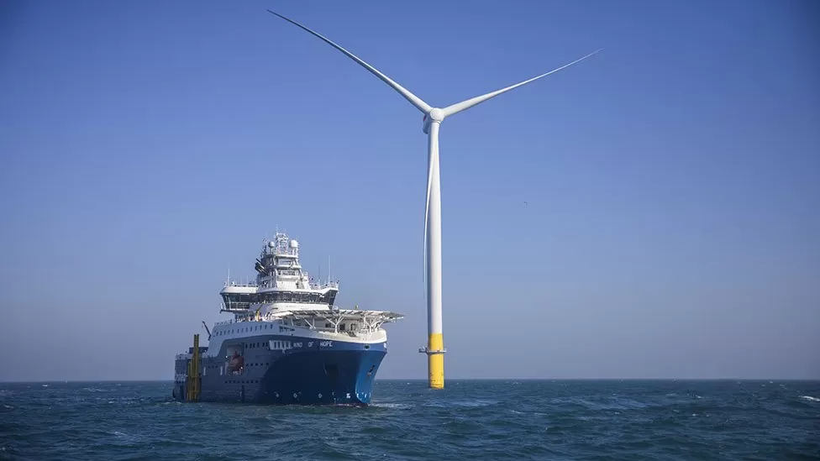
The End
Notes:
I leave you with a positive picture. This week the UK opened Hornsea 2 off the coast of Yorkshire. It is part of planned series of 4 farms.
Hornsea 1 1.2 GW
Hornsea 2 1.8 GW - estimated 1.4m homes 200m tall. One rotation takes 6 secs and provides enough energy to power a home for a day
Hornsea 3 2.4 GW
Hornsea 4 unknown but likely to above 2
UK has a total Pipeline for wind of 86 GW. This will take time.
Unfortunately the government are against onshore wind, which can erected much quicker.
The End

Slide 17
Other useful slides

Slide 18
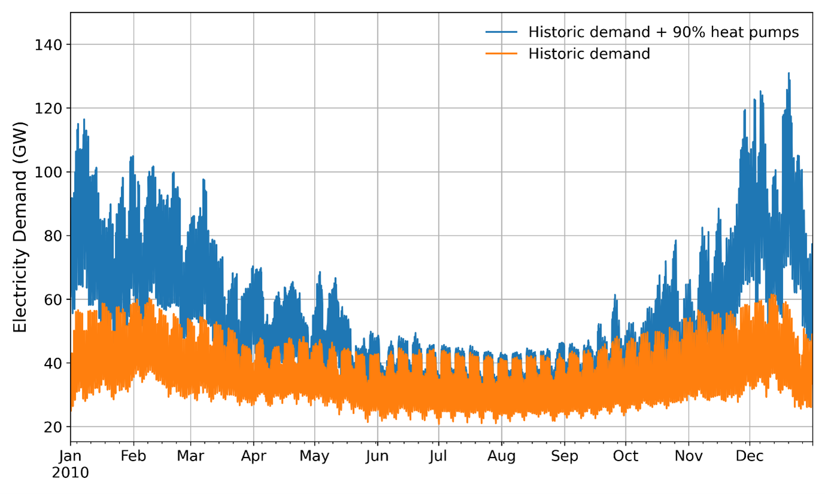
Notes:
https://www.ucl.ac.uk/bartlett/energy/news/2022/feb/heat-pumps-uk-homes-how-will-they-be-powered

Slide 19
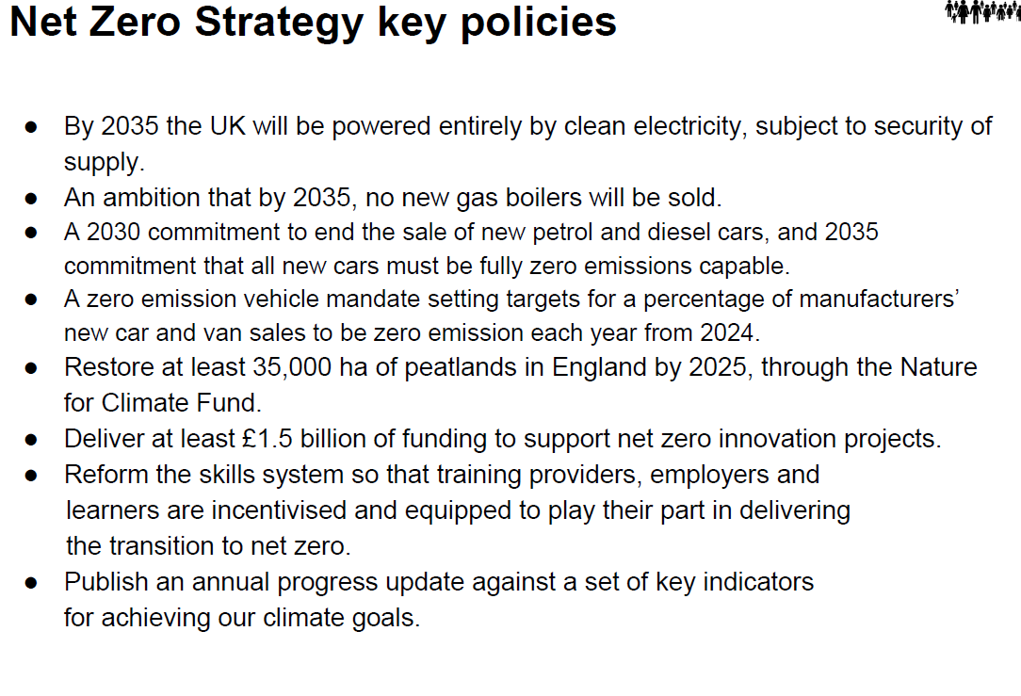

Slide 20
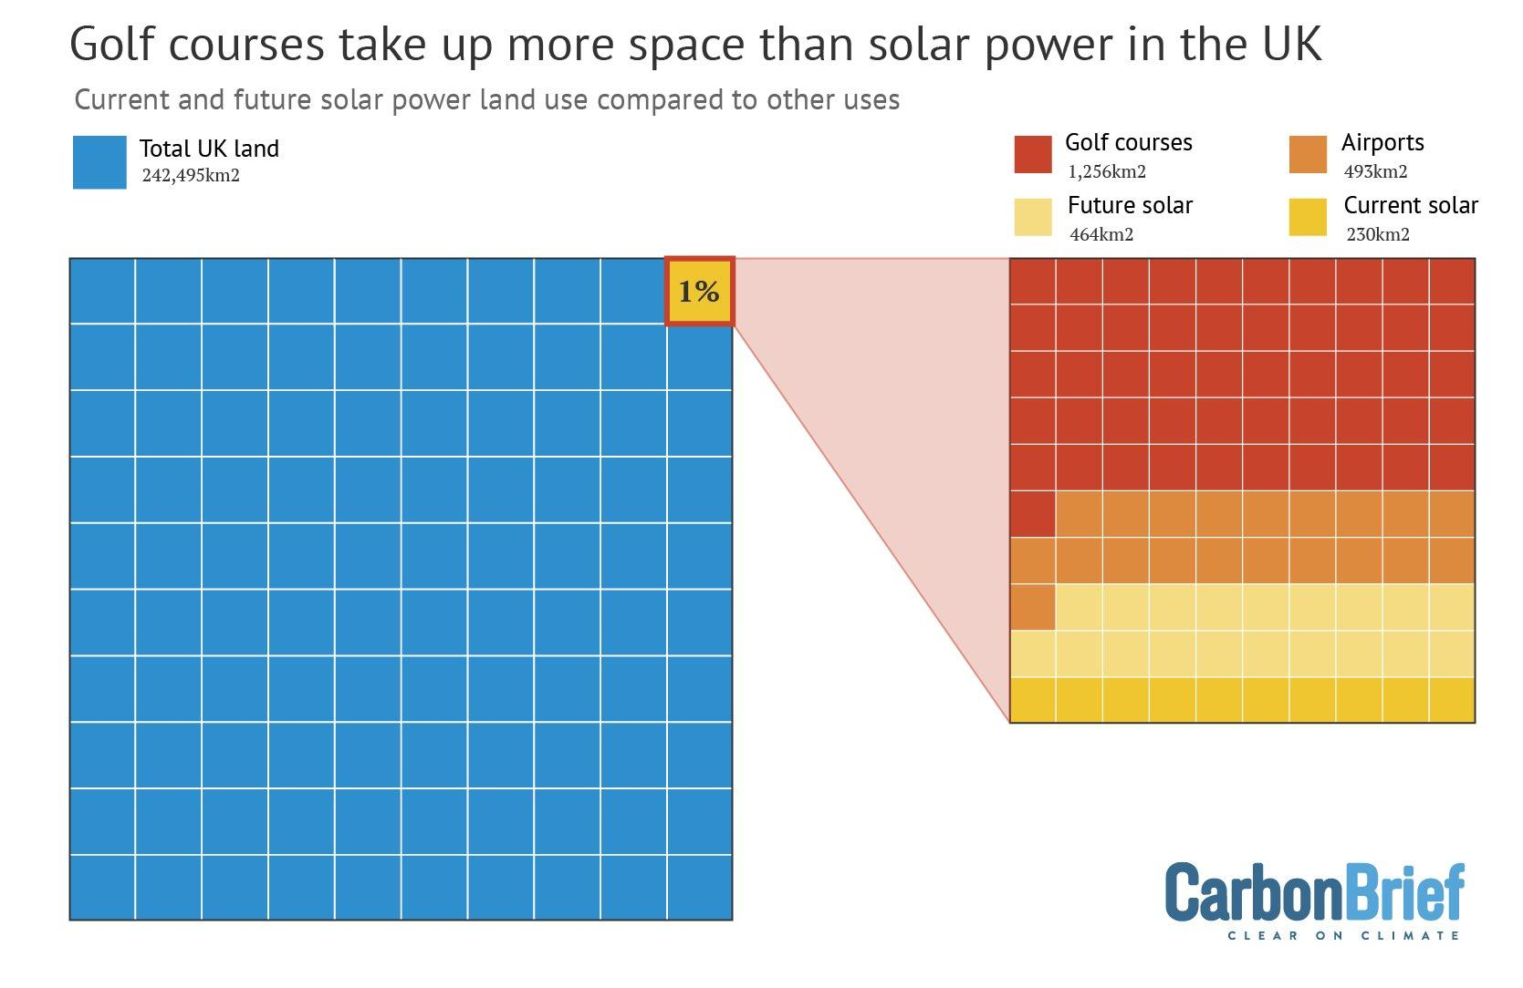

Slide 21
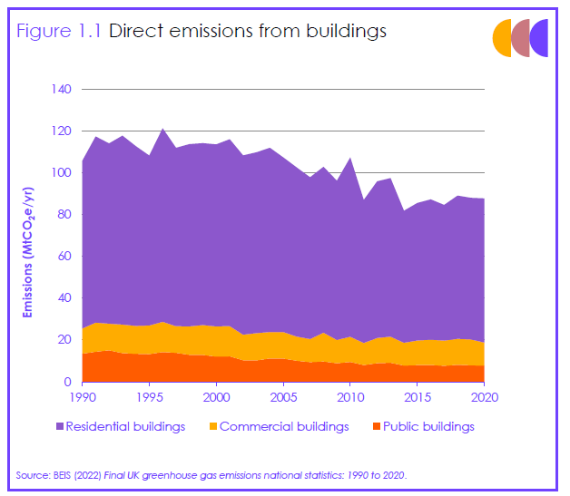
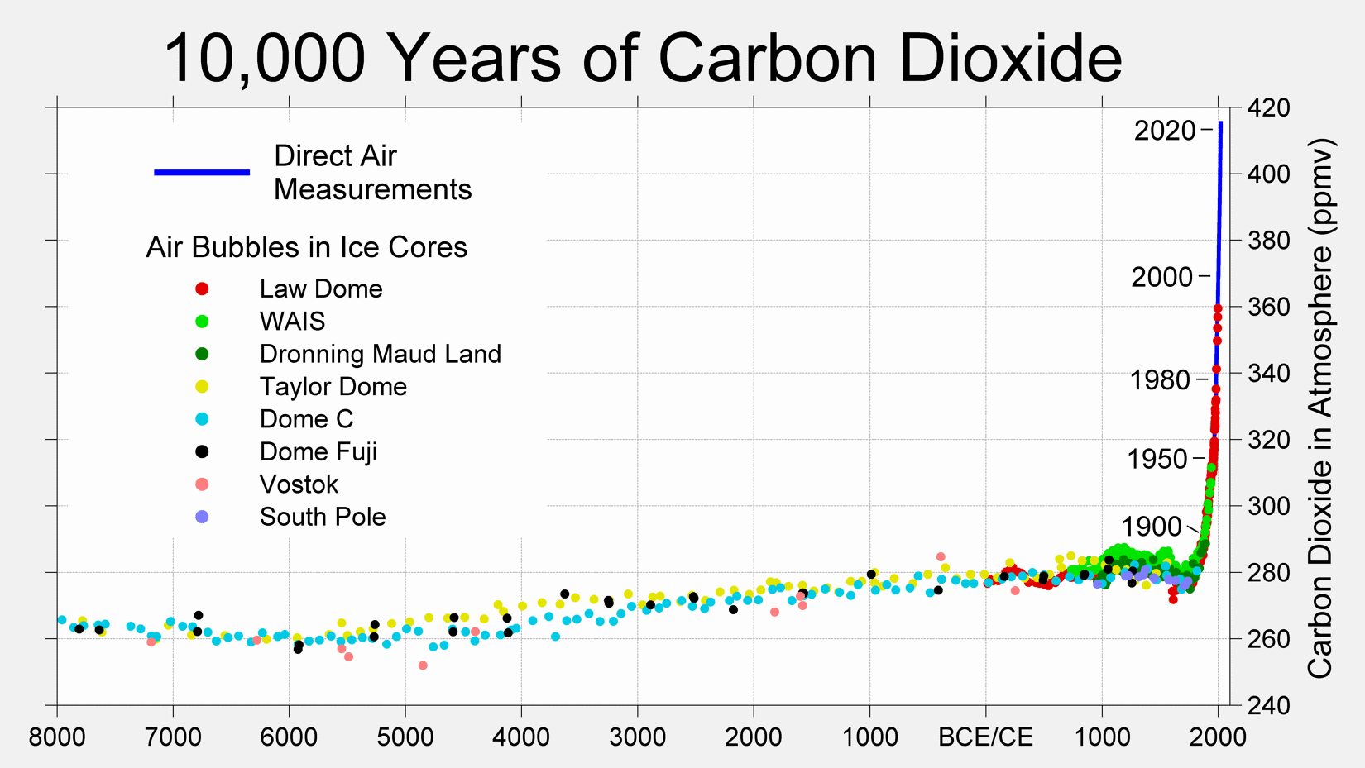

Slide 22
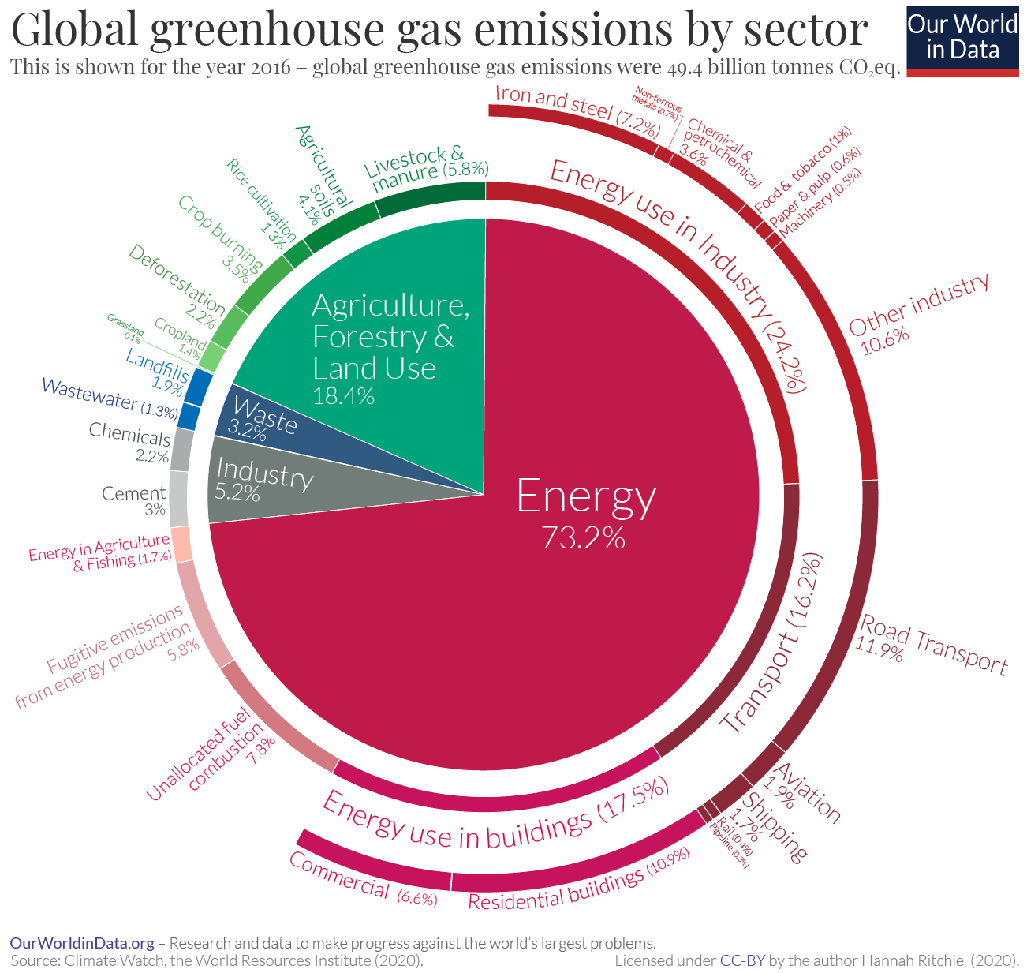

Slide 23
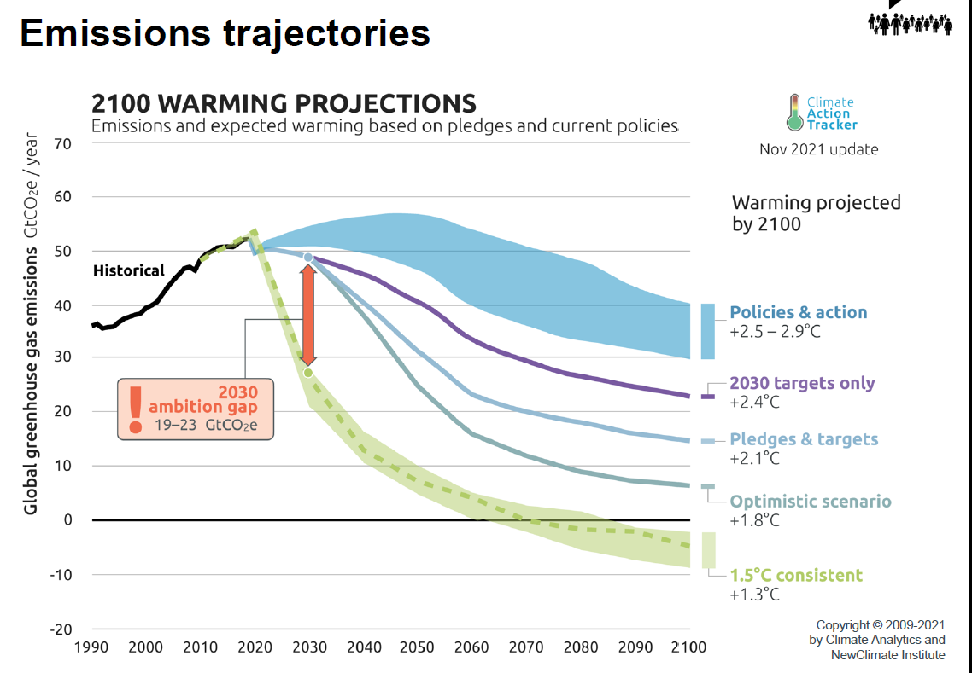

Slide 24
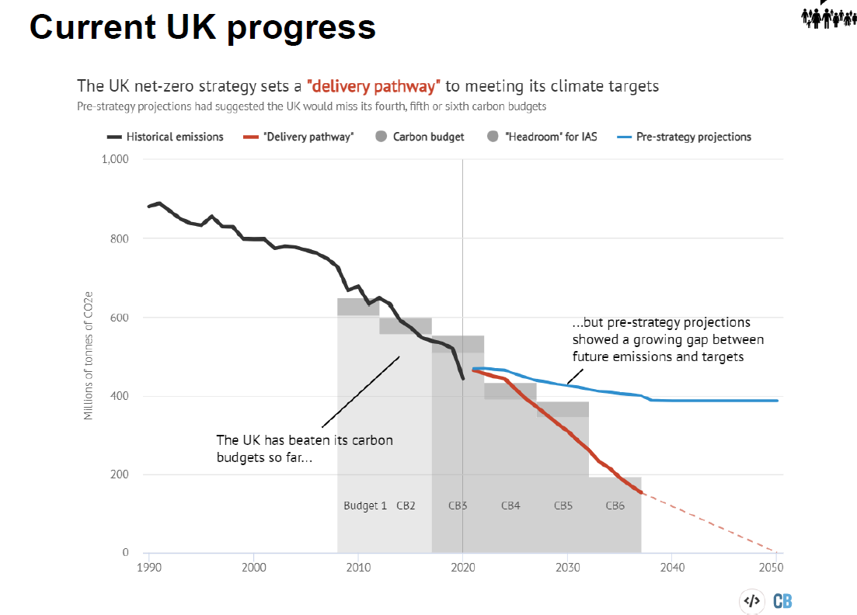

Slide 25
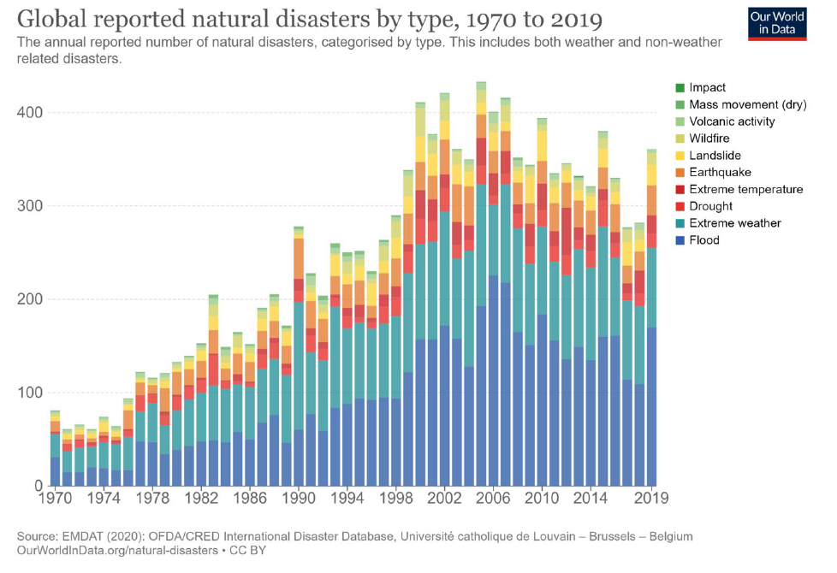

Slide 26
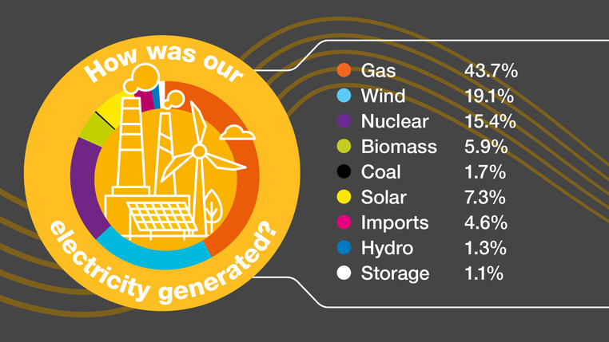
Notes:
July 2022 Electricity Generation

Slide 27
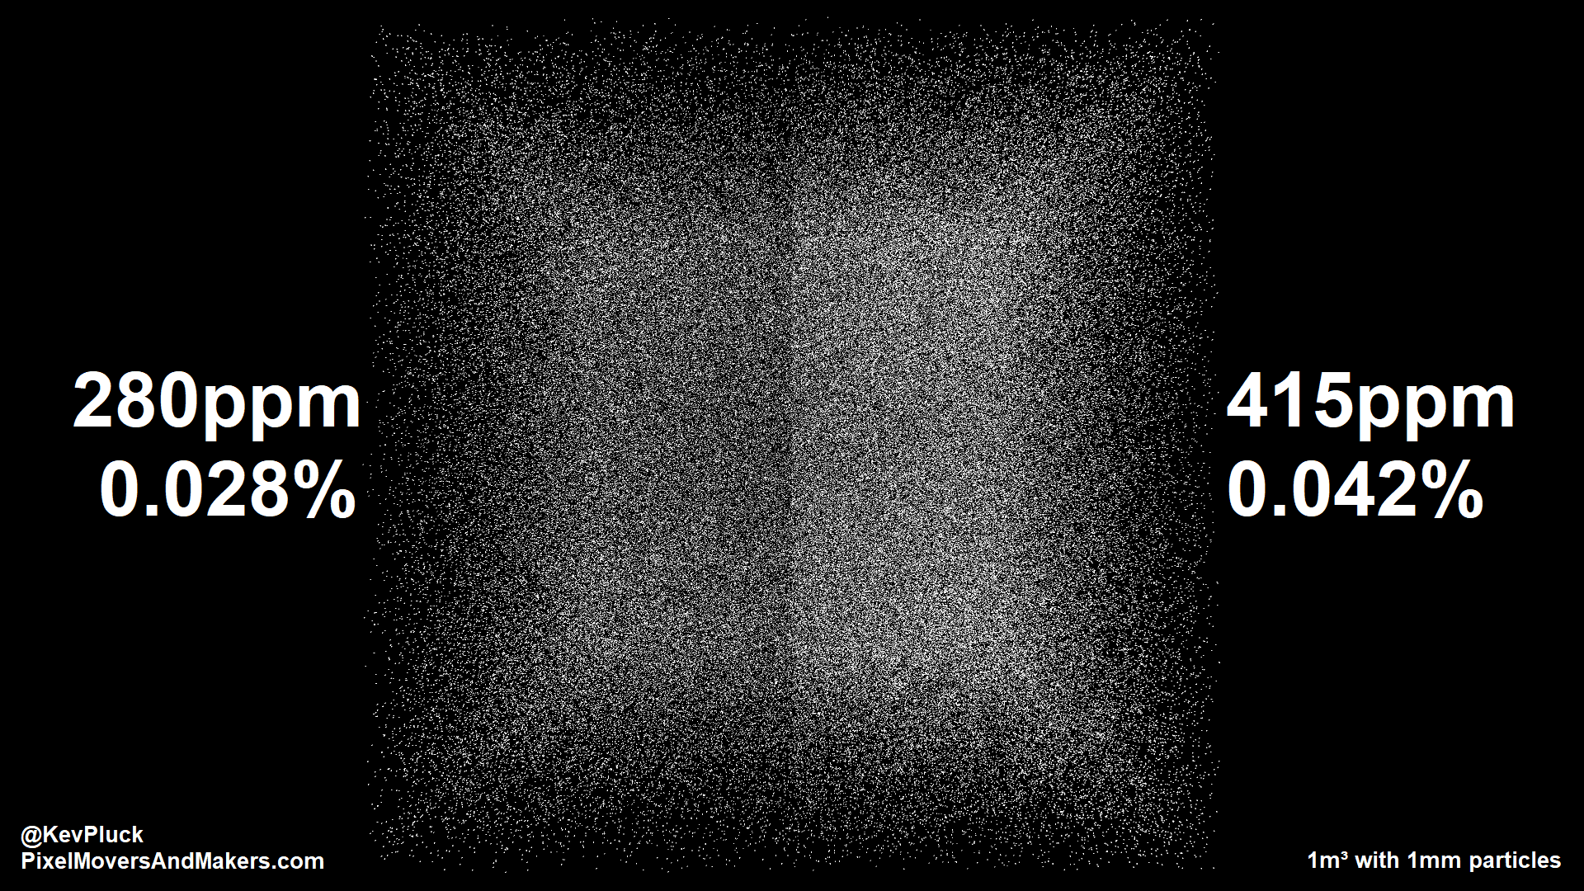
Notes:
If you think that 0.04% of the atmosphere is small - this is what it looks like
Ozone is only 0.001% and that blocks 99% of all Ozone.

